Slide 1


AI Profiling For Specific Sectors

Slide 2




Researched and Prepared by :
KARTHIK THALLAM
500188370
URMI PAREKH
500186977
SWAPNIL BANDGAR
500186962
ASHISH SHARMA
500188494

Slide 3
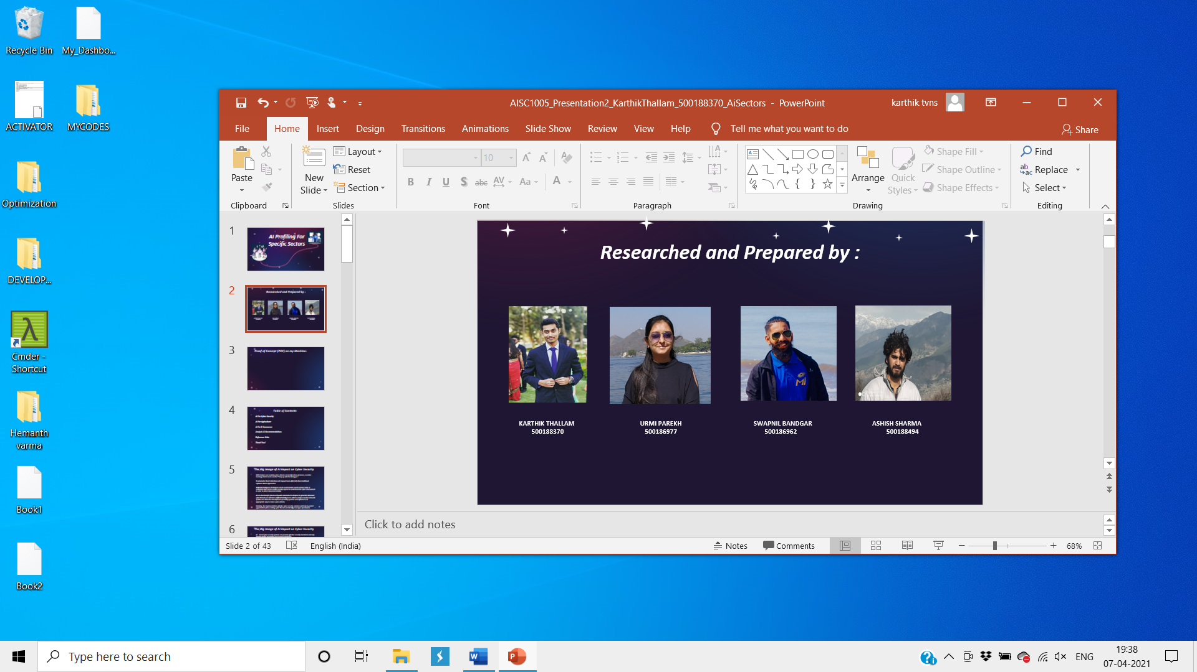
Proof of Concept (POC) on my Machine:

Slide 4
Table of Contents
AI For Cyber Security
AI For Agriculture
AI For E-Commerce
Analysis & Recommendations
Reference Links
Q & A!

Slide 5
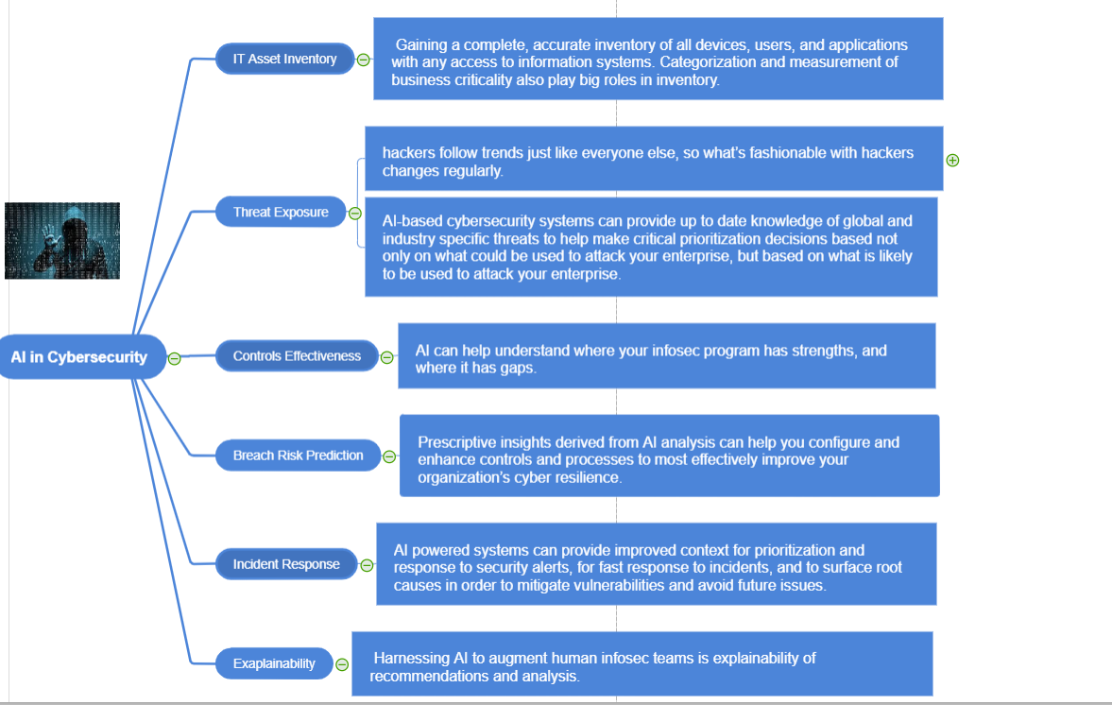
Mind Map for Cyber Security

Slide 6
The Big Image of AI impact on Cyber Security
With today’s ever evolving cyber-attacks and proliferation of devices, machine learning and AI can be used to “keep up with the bad guys”.
It automates threat detection and respond more efficiently than traditional software driven approaches.
Artificial intelligence techniques can be used to learn how to remove noise or unwanted data and to enable security experts to understand the cyber environment in order to detect abnormal activity.
Ai can also benefit cybersecurity with automated techniques to generate whenever cyber threats are detected. Artificial Intelligence is able to analyze massive amounts of data and allow the development of existing systems and software in an appropriate way to reduce cyber attacks.
Similarly, the implementation of AI for cyber security solutions will help to protect organizations from existing cyber threats and identify new types of malware.

Slide 7
The Big Image of AI impact on Cyber Security
AI – based cyber security systems can provide effective security standards and help develop better prevention and recovery strategies.
The use of AI for cyber security helps to create a dynamic, real – time, global authentication framework that changes location or network access privileges.
More than 90 percent of US and Japan’s cybersecurity professionals expect attackers to use AI for the companies they are working for, according to a study by Webroot.
Enterprise AI initiatives have a wide range of potential vulnerabilities, including malicious corruption or manipulation of training data, implementation and component configuration.
Ai offers a huge potential for helping to overcome the challenge and evolve to help organizations improve their cybersecurity attitudes through intelligent code analysis and configuration analysis and activity monitoring.

Slide 8
The Big Image of AI impact on Cyber Security
Threat Hunting :- Traditional security techniques use signatures or indicators of compromise to identify threats. Signature-based techniques can detect about 90% of threats. Replacing traditional techniques with AI can increase the detection rates up to 95%, but we will get an explosion of false positives.
Vulnerability management :- AI and machine learning techniques like User and Event Behavioral Analytics (UEBA) can analyze baseline behavior of user accounts, endpoint and servers, and identify anomalous behavior that might signal a zero-day unknown attack.
Behavioral Analysis:- AI can develop a pattern by accessing users’ working methods. If any malware is introduced in the system, the working way would be changed, and that’s where the AI would detect the abnormality and report it to the authorities.

Slide 9
The Big Image of AI impact on Cyber Security
Data centers :- AI can optimize and monitor many essential data center processes like backup power, cooling filters, power consumption, internal temperatures, and bandwidth usage.
Network security:- Companies can leverage AI to improve network security by learning network traffic patterns and recommending both functional grouping of workloads and security policy.
Improving the Authentication:- With modern biometric authentication methods such as face recognition and iris recognition, login authentication has become highly secure and comfortable. The use of AI in biometrics has ensured that cybercriminals cannot hack them.

Slide 10
Main & Popular Related Apps, Tools, Platforms, Solutions
bioHAIFCS
bioHAIFCS is a bio-inspired hybrid artificial intelligence framework for cybersecurity.
This framework combines timely and bio-inspired machine learning methods suitable for the protection of critical network applications, namely military information systems, applications and networks.
More specifically, it combines the hybrid evolving spiking anomaly detection model (HESADM), which is used to prevent cyber-attacks, which cannot be avoided otherwise by — using passive security measures; the evolving computational intelligence system for malware detection (ECISMD); and the evolutionary prevention system from SQL injection (ePSSQLI) attacks.

Slide 11
Main & Popular Related Apps, Tools, Platforms, Solutions
Cyber Security Tool Kit (CyberSecTK)
The cybersecurity toolkit, CyberSecTK, is a Python library for preprocessing and feature extraction of cyber-security-related data. The purpose of this library is to bridge the gap between cybersecurity and machine learning techniques.
The toolkit is basically a suite of program modules, datasets as well as tutorials supporting research in cybersecurity. The CyberSecTK works by helping cyber experts to implement a basic machine learning pipeline from scratch.
The challenge is that cyber security experts do not have necessary trainings to apply machine learning to their problems. The goal of this library is to help bridge this gap.
This will help cyber experts to implement a basic machine learning pipeline from beginning to end.

Slide 12
Main & Popular Related Apps, Tools, Platforms, Solutions
Cognito by Vectra
Cognito by Vectra is an AI tool that detects and responds to attacks inside the cloud, data center, IoT, and enterprise networks.
Some of the benefits of using Vectra Cognito platform includes automated threat detection, empowering threat hunters, providing visibility across entire deployment and other such.
The Cognito platform for NDR is in 100% service of detecting and responding to attacks inside cloud, data center, IoT, and enterprise networks. Our job is to find and stop those attacks early and with certainty. The Cognito platform meets SOC 2 Type 2 compliance standards, ensuring the security and confidentiality of our partners' and customers' data.

Slide 13
Main & Popular Related Apps, Tools, Platforms, Solutions
DefPloreX
DefPloreX is a machine learning toolkit for large-scale e-crime forensics. It is a flexible toolkit that is based on the open-source libraries to efficiently analyse millions of defaced web pages.
DefPloreX or Defacement eXplorer uses a combination of machine learning and data visualization techniques to turn unstructured data into meaningful high-level descriptions.
One of the most interesting aspects of DefPloreX is that it automatically groups similar defaced pages into clusters and organises web incidents into campaigns.

Slide 14
Main & Popular Related Apps, Tools, Platforms, Solutions
IBM QRadar Advisor
IBM QRadar Advisor with Watson uses IBM cognitive artificial intelligence to assist users with the incident and risk analysis, triage and response, enables security operations teams and more.
The tool helps in reducing the time spent investigating incidents from days and weeks down to minutes or hours.
It automates routine SOC tasks, finds commonalities across investigations and provides actionable feedback to analysts, freeing them up to focus on more important elements of the investigation and increase analyst efficiency.

Slide 15
Main & Popular Related Apps, Tools, Platforms, Solutions
StringSifter
StringSifter is a machine learning tool which ranks strings automatically based on their relevance for the malware analysis.
It is built to sit downstream from the Strings program.
This means it gets a list of strings as input and delivers the same strings as output ranked according to their relevance for malware analysis.

Slide 16
Main & Popular Related Apps, Tools, Platforms, Solutions
Sophos’ Intercept X tool
Sophos’ Intercept X tool is a cybersecurity tool that is integrated with a deep learning neural network that works by changing the endpoint security from a reactive to a predictive approach to protect against both known and never-seen-before threats.
Sophos Intercept X employs a comprehensive defense-in-depth approach to endpoint protection, rather than simply relying on one primary security technique.
The features of this tool include enforcing data execution prevention, stack pivot, heap spray allocation, among others.

Slide 17
Main & Popular Related Apps, Tools, Platforms, Solutions
Targeted attack analytics (TAA) by Symantec
Targeted attack analytics (TAA) tool is developed by Symantec to deliver various benefits, such as cloud-based analytics that automatically adapt to new attack techniques, continuously delivered attack detections plus the ongoing addition of new attack analytics and more.
It also provides benefits to Advanced Threat Protection customers by multiple incidences of attack detections combined with AI-driven and human analysis customized to each customer’s environment.

Slide 18
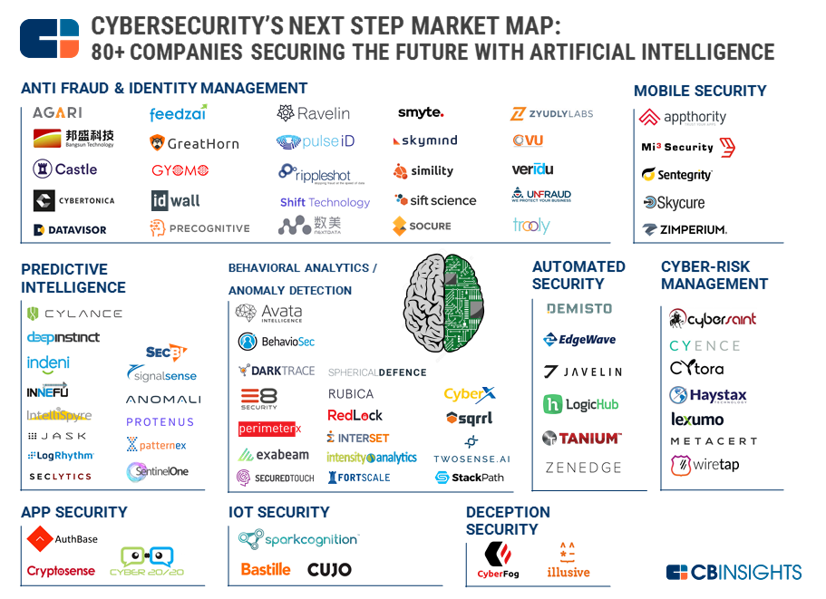
Main Related Players, Companies, Projects.

Slide 19
Main Related Players, Companies, Projects.
TESSIAN
Tessian’s AI security platform prevents breaches, spear phishing and data loss from harmful emails. The company builds customizable email filters that stamp out malicious and suspicious activity in both inbound and outbound emails. The platform also comes with a real-time dashboard so security teams can instantly keep up with the health of their infrastructure.
WHITE OPS
White Ops enacts machine learning and AI to predict security breaches and stop malicious bot activity. By using artificial intelligence to connect millions of points at one time, White Ops predicts the presence of automated bot traffic and automatically blocks the traffic before it becomes dangerous to financial transactions or back-end infrastructure.

Slide 20
Main Related Players, Companies, Projects.
TRUU
The TruU Identity Platform automatically monitors and analyzes transactions between the digital and physical world to determine security risks through a mixture of biometrics, interactions and behaviors. TruU’s AI collects data on the aforementioned criteria and alerts to any suspicious activity that doesn’t fit with a trusted user profile.
ANOMALI
Anomali provides technology to help businesses and organizations identify suspicious activity before it’s in their networks. The company's threat intelligence solutions allow security teams and analysts to identify threats and adversaries as well as collaborate with other organizations to share their findings.

Slide 21
Main Related Players, Companies, Projects.
CROWDSTRIKE
Crowdstrike provides cloud-native endpoint protection software. The company's platform, Falcon, offers prevention, visibility across endpoints and proactive threat hunting to customers in industries like finance, healthcare and retail. Working beyond simple detection, the Falcon platform automatically investigates threats and takes the guesswork out of threat analysis.
DARKTRACE
With more than 30 offices around the world, Darktrace has helped thousands of companies in a variety of industries detect and fight cyber threats in real time. Darktrace’s AI platform analyzes network data to make calculations and identify patterns. Machine learning technology uses the data to help organizations detect deviations from typical behavior and identify threats.

Slide 22
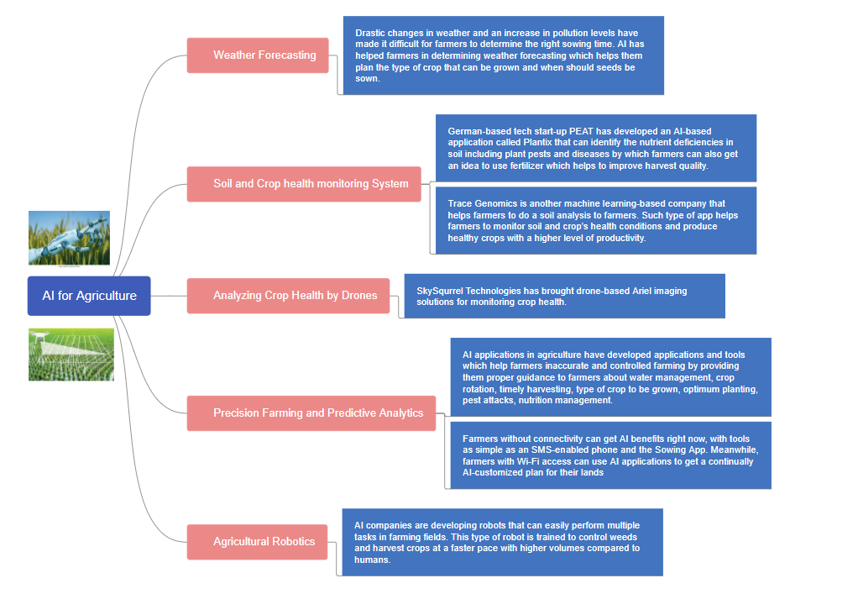
Mind Map for Agriculture

Slide 23
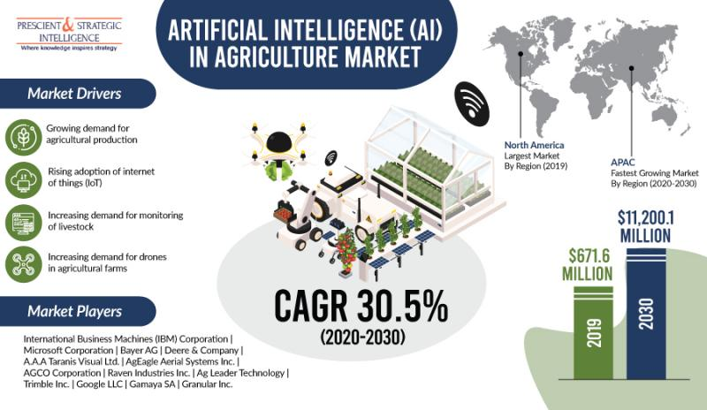
The Big Image of AI impact on Agriculture:

Slide 24
The Big Image of AI impact on Agriculture:
Challenges faced by farmers using traditional methods of farming:
Increasing deforestation and pollution result in climate changes which makes difficult for farmers to make wise decisions on preparing the soil and harvesting
Every crop requires certain nutrients in the soil and the deficiency of nutrients like Nitrogen, Phosphorous and Potassium can lead to poor quality of crops
The weed protection plays an important role in the agriculture lifecycle and it needs to be controlled to hinder the increase in production cost.
These challenges faced by the farmer can be removed in a most efficient way with the help of Artificial Intelligence
Some of the Applications of AI in the Agriculture will be discussed in the next slides

Slide 25
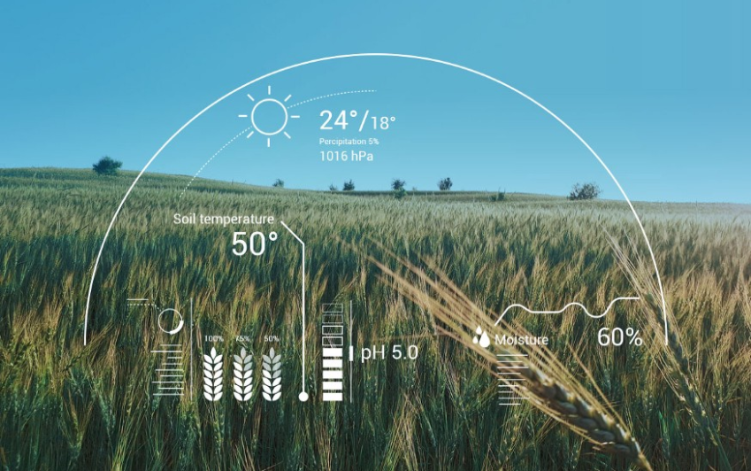
Main & Popular Related Apps, Tools, Platforms, Solutions
Weather Forecasting :- Helps farmers to analyze weather conditions and plan what type of crops need to be grown accordingly
Soil and Crop Health Monitoring System :- Helps to monitor the soil quality which plays a crucial role for farmers to plan what type of crops need to be grown
AI enabled system to detect pests:- Helps farmers to be aware if any insect has landed and also tells which type of insect using satellite images and compare them with the historical data. It helps farmers to overcome the problems created by their enemies called ‘pests’

Slide 26
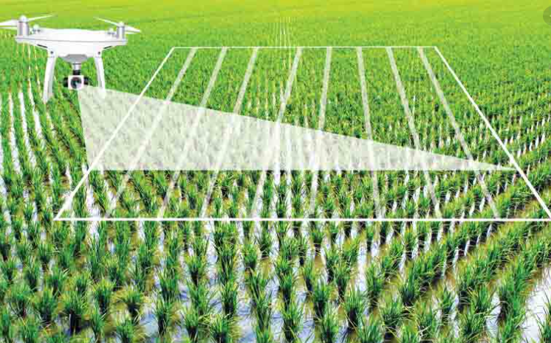
Main & Popular Related Apps, Tools, Platforms, Solutions
Analyzing crop health by drones :- Helps farmers to identify pests and bacteria there by helping them farmers to timely use of pest control and other methods to take required action
Precision Farming & Predictive Analytics :- Helps farmers evolve into agricultural technologists, using data to optimize yields down to individual rows of plants
Agricultural Robotics:- These are trained robots and helps to check the quality of crops and detect weed with picking and packing of crops at the same time

Slide 27
Main Related Players, Companies, Projects:
Blue River Technology :-
Specialist in Weed Control
They developed ‘See & Spray’ robot which is integrated with Computer Vision and sprays weed in cotton plants
Harvest CROO Robotics:-
Specialist in Crop Harvesting
The company claims that their robot is capable of harvesting 8 acres in a single day which can also replace 30 human laborers
PEAT:-
Specialist in Machine Vision for diagnosing Pests / Soil Defects
The company claims that their application called Plantix can quickly achieve pattern detection with approximately 95% accuracy

Slide 28
Main Related Players, Companies, Projects:
Trace Genomics:-
Specialist in Machine Learning for diagnosing soil defects
They developed a system that provides clients with a sense of their soil’s strengths and weaknesses using Machine Learning
Sky Squirrel Technologies Inc:-
Specialist in Drones and Computer Vision for Crop Analysis
They developed an algorithm which is integrated with images and analyze the captured images there by providing a detailed report on vineyard health
Farm Shots:-
Specialist in Satellites for Monitoring Crop Health and Sustainability
The company aims to detect diseases, pests and poor nutrition on farms with their applications

Slide 29
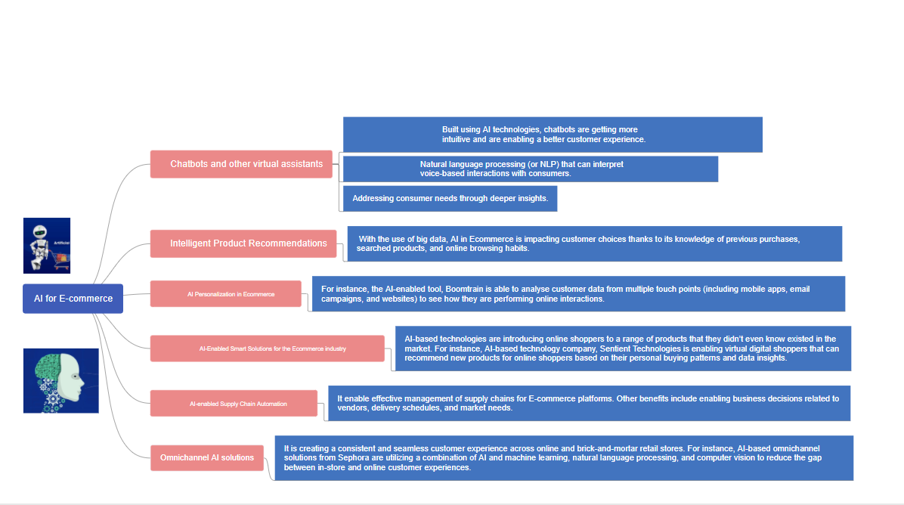
Mind Map for E-Commerce

Slide 30
The Big Image of AI impact on e-commerce
Artificial intelligence is enabling companies to predict, sense, and automate.
AI can improve user experience and increase brand reputation.
AI is helping the start-ups, manufacturers, and retailers to set a new example in the industry.
AI is having enormous implications in the way retailers sell their products & services and the way consumer buys them.
AI can solve real-world issues that ecommerce businesses are facing.
AI is has a deeper and stronger grip on future of doing business.
After Google acquired DeepMind, an AI startup having specialism in machine learning and algorithms – other IT giants such as Facebook, Microsoft, also followed the trend and showed a keen interest in exploring further possibilities pertaining to AI.
A Business Insider articles predicts that as much as 85% of customer interactions will be without a human in coming years.
Introducing AI also enables them to identify fake reviews posted by sellers. In the language of Marketing Warfare, it is called – a high level of customer care.

Slide 31
The Big Image of AI impact on e-commerce
Products recommended to customers while browsing through the site is chosen by the AI mechanism.
Customers are more likely to buy recommended items related to what they have already seen or searched for on an eCommerce portal.
Use of AI-enabled applications is allowing eCommerce businesses to increase their sales while keeping their procedures simple yet more accurate.
The efficacy of any website CRM can be enhanced manifold by integrating AI.
However, with that, some webmasters will need to update their backend to advanced product options.
Businesses are overloaded and confused with the bulk of data they have gathered through various sources.
This also includes the data of their past consumers.
AI can help businesses to find potential customers based on their interests and browsing history.
Smart ads backed by AI show you the same product for certain period or until you choose to close them.

Slide 32
The Big Image of AI impact on e-commerce
Reselling has always been a key driving force for businesses across industry.
In eCommerce as well, pitching ex-customers can offer multiplied gains. With the help of AI-based CRM, sales teams can find which customers might be interested in buying related products, accessories, or reordering.
AI have marketing channels that use artificial intelligence to help the marketers show their ads only to those people who fall in their buyer persona.
Customers want to learn every aspect of a product they are willing to buy. That’s why they compare specifications and most importantly, price of a product being offered by different sellers on different websites. They have a long list of questions to be answered.
AI Chabot are being used by almost all eCommerce giants these days. They efficiently handle customer queries and resolve customer.
AI can also help customers find the right product for their needs. Moreover, it makes way for an advanced level of personalization. Offering personalized experience or content to the user increases chance of sales.

Slide 33
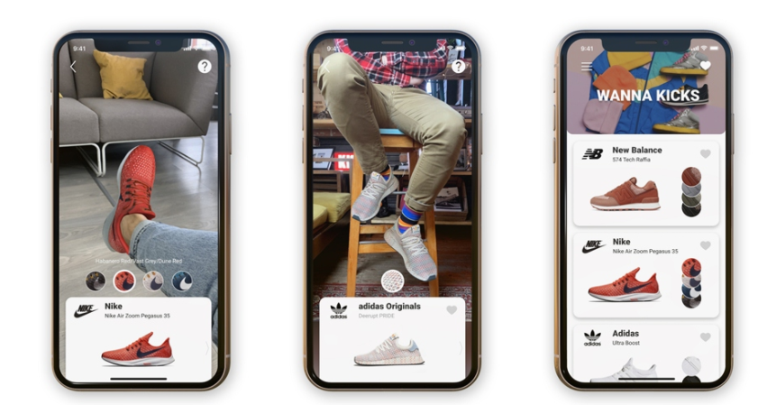
Main & Popular Related Apps, Tools, Platforms, Solutions
Advanced Visual Search:

Slide 34
Advanced Visual Search:
The AI-based visual search technology uses real-world images such as snaps, screenshots, internet images, etc. for online searches.
AI firstly understood the content of the image and then comes up with the relevant results.
AI is helping the ecommerce business, especially for clothing and home décor industry.
Giants like Google, Amazon, Pinterest, Bing, and many ecommerce owners have started to develop their own visual search engines.
We must have heard of Google Lens which can detect over 1 billion objects.
Many of the famous retailers that are leveraging the advanced AI-based visual search are ASOS, eBay, Walmart, Levi’s, Disney, Salesforce, Snapchat, Ikea, and Lifestyle.
Once customer buys certain product AI provide suggestions with different visual options which will boost the customer interaction with web.
Due to advance visualizations more customers are attracted towards the website which leads to more sell.
AI gives different options to seller as well to provide better visualization of product to customers.

Slide 35
Personalized Recommendations:
You must have observed that in ecommerce stores such as Amazon, when you wander through shoes, then you can many recommendations on your dashboard of the similar shoes you were looking. And this personal touch by the ecommerce store makes you feel valuable and an important customer.
These personalized recommendations by AI enhance the customer experience.
The product related to the search is carefully tracked and accordingly, the most appropriate suggestion reaches users.
Search engine analysis, along with AI identify the user’s priority.
The recommended items are always based upon user’s recent activity such as frequently viewed products, considered or purchased with the one the customer is currently considering.
Lets say suppose if the customer is spending a lot of time near a shelf or a product making their decisions.
Then that information is stored in the data record. This helps the shop owners to determine what is the demand of their buyer.

Slide 36

Voice Assistance:
AI is getting advanced, many new technologies are emerging in the ecommerce industry for better customer experience. Voice assistance is foremost of them.
AI gives a smooth experience to users to find products and shop them.
The customer who finds typing quite a hassle can easily shop through the voice search. If you have a smart voice assistant such as Amazon Alexa, you just need to find the product by speaking to it and then can make an order.
Since smartphones and people are now hard to separate, a voice interface can be the next leap in ecommerce evolution.
Ordering and shopping using natural speech is faster and allows people to do other things instead of focusing on texting.
Google’s Alexa, Apple’s Siri can be your personal shopping assistants in the home. In addition to messenger bots, Voice assistants are the new tools allowing users to communicate with web services using only their voice command.

Slide 37
Automated Product Description :
The product description on an ecommerce site can make it big or can destroy.
Regardless of the image of the product, if the description of the product is not filled properly, you can lose the trust of your customers.
However, manually entering the product description through your employees can be a very long & tedious process.
It will also result in increased employee costs and have significant chances of human prone errors.
AI can resolve this problem by automating the process of writing details of the product.
AI will not only copy the details of the product from the manufacture but will automatically find all the latest product-related relevant information.
AI can see which details of the product are most frequently included in keywords, AI content software understands just the right details which are to include to promote Wi-Fi-enabled food processors.
The benefits offered by the automated product descriptions are:
AI can create multiple product details per hour
Products description are not prone to any error and include demanding details
AI can also check the effectiveness of the description and can make certain changes if required.
Dynamic pricing that maximizes revenue and sales volume

Slide 38

Internet of Things (IoT):
Internet of Things or IoT has been the latest buzz. It is enabling devices to exchange data with each through the internet. It is also helping retail and ecommerce businesses to make smooth their operation.
IoT helps ecommerce by inventory management, warehouse management, supply chain management, and providing a better customer experience.
Using IoT sensors and RFID tags it is possible to maintain the inventory in real-time.
IoT is not limited to optimizing inventory but also helps you eliminating the over-stock of items.
Temperature sensors can give you info & notifications about perishable products.
Amazon uses warehouse robots to enhance the effectiveness of its picking and packing process.
IoT can help in customer experience by providing insights about the products which are popular on social media.
We can also target a specific group of customers using IoT. It can recognize the shopping pattern in search trends and online browsing.

Slide 39
Data Management:
As the adage goes “Data is the new oil”. Hence, you as a site owner should maintain your customer data wisely.
The data such as purchasing details, customer profiles, and transferring other information freely tax traditional database software, but not AI.
AI can manage your data effectively. By placing product descriptions, images, and customer data in raw form, artificial intelligence does not need to sort through data structures while using data for different web applications.
The benefits of AI in data management are:
No restrictions on handling data
Greater Flexibility
Storage of different type of data in a common location
No affect in scalability
Potential-valuable data

Slide 40

Automation in Warehouse:
When a customer makes an order, the information is sent to the respective warehouse software, the software communicates with the robot, and then the robot is sent to take the purchased goods out of stock, box them, and prepare them to ship.
Warehouse automation are getting driven by AI-based smart robots, which tout stock items 24×7 and continue to work without a lunch break.
Smart robots can do everything but drive a delivery truck. But who knows the future…
The other benefits of warehouse automation are:
Better accuracy
Eliminates the potential threats of human injuries in the warehouse
Fast stocking and retrieval
Results in low labour cost
A few chances of stock damage

Slide 41
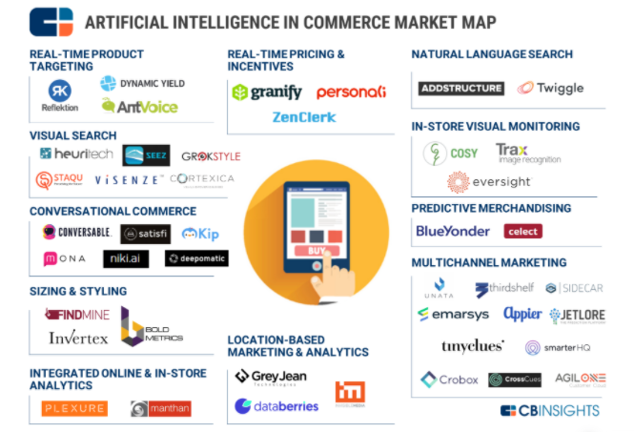
Main Related Players, Companies, Projects.

Slide 42
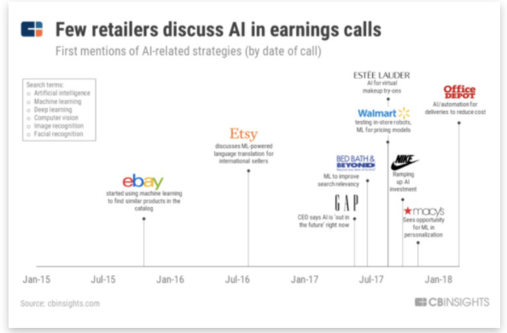
Main Related Players, Companies, Projects.
Many companies are taking a Lean Startup approach and rapidly deploying projects to test and learn.

Slide 43
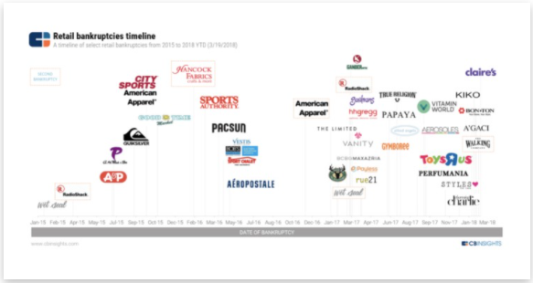
Main Related Players, Companies, Projects.
Many companies that have failed to adapt to customer and technology trends are shutting down operations.
Many companies are taking a Lean Start-ups approach and rapidly deploying projects to test and learn.
Below are the data provided by different firms using AI.

Slide 44
AI for Cyber Security Insights
AI in Cybersecurity is playing an important role in analysing data from large number of cyber incidents and using the data to detect potential threats.
By recognizing the attackers’ pattern, infiltrating methods can be discovered, and it becomes easy to distinguish when and how any vulnerability would make its way to the network
Many organizations are still using traditional way of entering the login ID and password for authentication purpose. There are high risk as mostly people use their same password for social media and organizational account which leads to high risk. However, with modern biometric authentication methods such as face recognition and iris recognition, login authentication has become highly secure and comfortable. The use of AI in biometrics has ensured that cybercriminals cannot hack them.
With cyber threats becoming intimidating use of AI in cybersecurity is the need of the hour. However, we need to develop a system which is simple and easy to use to avoid complexity.

Slide 45
AI for Agriculture Insights
Artificial Intelligence (AI) is changing the overall agriculture Department. It is ranging from processing algorithms, drones, robots and intelligent monitoring systems to on-farm sensors with the applications. This could have a positive impact on the agricultural economy and environmental sustainability. AI in Agriculture is helping to improve the overall harvest quality and accuracy – known as precision agriculture.
AI technology has helped in detecting disease in plants, pests and poor nutrition of farms.
As per the researchers, prediction it is predicted that digital farming and connected farm services will impact 70 million Indian farmers.
Although in the future of farming, the AI will defiantly change the daily operations of the traditional family farm is yet to be seen. However, with new Agri-tech companies, who are producing increasingly accessible technologies; the ‘Digital Farming’ seems much closer than we think.

Slide 46
AI for E-Commerce Insights
AI is helping customers in E-commerce by the knowledge of their previous purchase, searched products.
AI is being utilized by online retailers for providing chatbot services, analyzing customer comments, and for providing personalized services to online shoppers.
Emotional AI, sentiment analysis helps a business understand the social sentiment of their brand, product or service by mining text that identifies and pulls subjective information from the source material. E-commerce companies like Amazon are already using Product recommendation feature and possesses a massive database of consumer purchase behavior to power its predictions.
AI inclusion can be hard to get off the bench, but in the future ecommerce economy it is critical to survive where we can define winners with the way they do with data, and how they scale their human capital.

Slide 47
References and Image Citations:
https://www.emizentech.com/blog/artificial-intelligence-impact-ecommerce-industry.html
https://towardsdatascience.com/top-12-ways-ai-is-revolutionizing-the-online-shopping-ecommerce-trends-9c3e98ef519c
https://www.newgenapps.com/blog/how-artificial-intelligence-is-affecting-the-ecommerce-industry/
https://www.bigcommerce.com/blog/ecommerce-ai/
https://yourstory.com/mystory/artificial-intelligence-ecommerce-start-using
https://www.linnworks.com/blog/artificial-intelligence-in-ecommerce
https://medium.com/@Countants/how-artificial-intelligence-is-transforming-the-e-commerce-industry-countants-scalable-custom-73ae06836d35#:~:text=With%20the%20use%20of%20big,products%2C%20and%20online%20browsing%20habits.&text=Improved%20customer%20retention%20and%20sales,a%20personalized%20business%20email%20campaign
https://onlinesales.ai/blog/artificial-intelligence-in-ecommerce/
https://www.balbix.com/insights/artificial-intelligence-in-cybersecurity/
https://www.computer.org/publications/tech-news/trends/the-impact-of-ai-on-cybersecurity
https://blog.eccouncil.org/the-role-of-ai-in-cybersecurity/
https://www.thesslstore.com/blog/artificial-intelligence-in-cyber-security-the-savior-or-enemy-of-your-business/
https://ciostory.com/cxo-perspective/use-of-ai-in-cyber-security/
https://www.analyticsinsight.net/impact-of-artificial-intelligence-in-cyber-security/

Slide 48
References and Image Citations:
https://www.analyticsinsight.net/impact-of-artificial-intelligence-in-cyber-security/
https://analyticsindiamag.com/top-8-machine-learning-tools-for-cybersecurity/
https://builtin.com/artificial-intelligence/artificial-intelligence-cybersecurity
https://www.cbinsights.com/research/cybersecurity-artificial-intelligence-startups-market-map/
https://cdn.openpr.com/T/5/T519652240_g.jpg
https://www.analyticsinsight.net/top-10-ai-and-robotics-companies-transforming-agriculture-sector/
https://www.analyticsvidhya.com/blog/2020/11/artificial-intelligence-in-agriculture-using-modern-day-ai-to-solve-traditional-farming-problems/#:~:text=While%20using%20the%20machine%20learning,with%20data%20like%20temperature%2C%20precipitation%2C
https://onlinesales.ai/blog/artificial-intelligence-in-ecommerce/
https://www.analyticsvidhya.com/blog/2020/11/artificial-intelligence-in-agriculture-using-modern-day-ai-to-solve-traditional-farming-problems/#:~:text=Precision%20Farming%20and%20Predictive%20Analytics,be%20grown%2C%20optimum%20planting%2C%20pest
https://www.sciencedirect.com/science/article/pii/S258972172030012X
https://www.computer.org/publications/tech-news/trends/the-impact-of-ai-on-cybersecurity

Slide 49

THANKS!

